Slide 1
Kalikow decomposition for the study of neuronal networks: simulation and learning
Patricia Reynaud-Bouret, LJAD – Institut NeuroMod
CNRS - Université Côte d’Azur
Colloquium Dauphine – April 1 2025

Slide 2
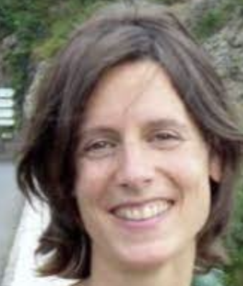
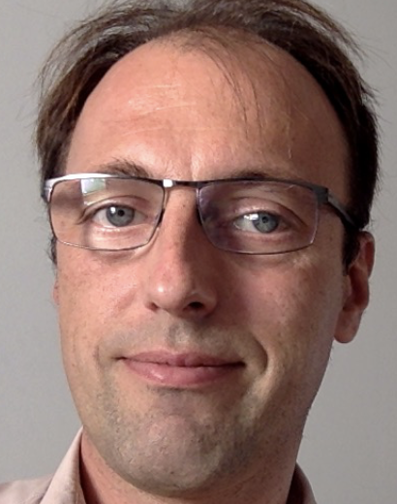
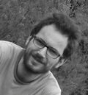
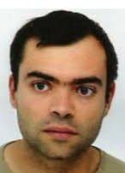
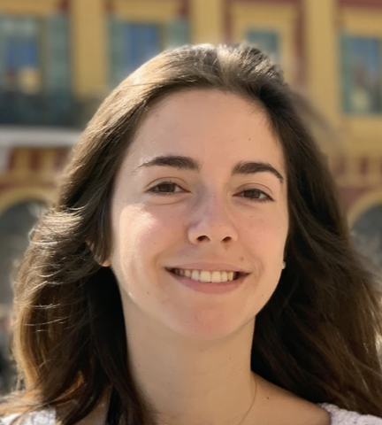
G. Ost,
UFRJ,
Rio de Janeiro
Brasil
S. Vaiter,
Université Côte d’Azur,
LJAD, Nice
E. Löcherbach,
Panthéon Sorbonne, Paris
E. Tanré, inria, Sophia
Muzy,
Uni. Côte d’Azur,
I3S, Sophia
G. Scarella,
Uni. Côte d’Azur,
LJAD, Nice
S. Jaffard ,
Université Côte d’Azur,
LJAD, Nice
C. Mascart,
Cold Spring Harbor, USA
T. C. Phi,
Kyoto University, Japan
G.Mezzadri,
Cog./ Decision Lab. Columbia

Slide 3
Contents
Kalikow decomposition in a nutshell (with a bit of neuroscience) and its classical application (existence)
→ Simulation of Spiking Neural Network
Derivation of local learning rules

Slide 4
Kalikow decomposition
Kalikow in 1990 constructed Random Markov process $X_{t}$
Pick $K$ in $ℕ$at random
Conditionnally to ${K, X}_{t}$ is a Markov chain of finite memory $K$
For A. Galvès and coauthors → chains of infinite memory.
A process $X_{t}$ satisfies a Kalikow decomposition if
there exists a probability $λ$ on finite neighborhoods
such that for any infinite past configuration $x,$
$$p\left(X_{t}=. | X_{−∞:t−1} =x\right)=λ\left(∅\right)p^{∅}\left(.,x\right)+\sum_{\begin{aligned}v non empty \\ finite neighborhood\end{aligned}}{λ\left(v\right)p^{v}(.,x)}$$
NB : a neighborhood = a finite subset of the past.
NB2 : $p^{v} (.,x)$ is a probability that only depends on $x_{|v}$
As a function of $x$ it is cylindrical

Slide 5
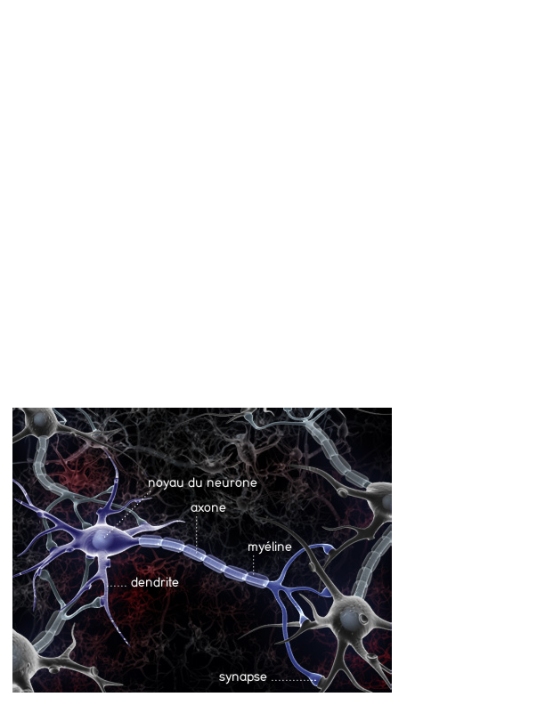
The neuronal network
voltage
Voltage / potential of the post-synaptic neuron
Action potential
or spike
time
Signals received
${10}^{11}$ neurons in a human brain with ${ →10}^{3}{−10}^{4}$ synapses per neuron
${10}^{8}$ for a rat or a small monkey
${10}^{6}$ for large areas like visual cortex
${10}^{4}$ for cortical barrels
Important features
Synaptic integration ~ summation of the entries with delay
Large potential → spike (0/1 phenomenon)

Slide 6
Models of neuronal networks
Usually in discrete time (binned data)
→ to use Kalikow decomposition
Values
0 = no spike in the bin
1 = (at least) 1 spike in the bin

Slide 7
Models of neuronal networks
Probability of spiking in the next bin given the past ?

Slide 8
Models of neuronal networks
Independence between the neurons given the past

Slide 9
Kalikow decomposition for models of neuronal networks
$p_{i}\left(x\right)$ is the probability of having a spike at 0 given the past configuration x in a stationary regime
Given a past configuration $x$, independently on each other,
each neuron I has a probability to spike
$$p_{i}\left(x\right)=λ_{i}\left(∅\right)p_{i}^{∅}\left(x\right)+ \sum_{v∈𝒱 \backslash \{∅\} }{λ_{i}\left(v\right)p_{i}^{v}\left(x\right)}$$
with $λ_{i}\left(.\right)$ probability on $𝒱$
Note the role of the empty neighborhood

Slide 10
Example : Hawkes process
Linear discrete Hawkes process
$$p_{i}\left(x\right)=ν_{i}+\sum_{j}{\sum_{\begin{aligned}T spike \\ of neuron j\end{aligned}}{h_{j→i}(t−T)}}$$
with $x_{j,s}$ the past value of neuron $j$, $s<0$ steps in the past
$p_{i}\left(x\right)=ν_{i}+\sum_{j}{\sum_{s}{h_{j→i}(−s)}}$ $x_{j,s}$

Slide 11
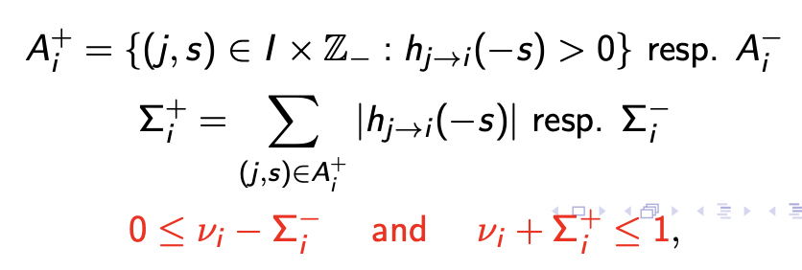
Example : Hawkes process
To simulate a Hawkes process given the past
I pick a couple (neuron,time) according to $λ$
If I pick $∅$I pick the value of $X_{i,t}$ at random
If it is excitatory ($A_{i}^{+})$, I copy paste the value
If it is inhibitory ($A_{i}^{−})$, I flip the value
$p_{i}\left(x\right)=ν_{i}+\sum_{j}{\sum_{s}{h_{j→i}(−s)}}$ $x_{j,s}$

Slide 12
Perfect simulation and existence
To simulate neuron $i$ at time 0 with Kalikow decomposition in stationary regime
Pick its neighborhood $V∼λ_{i}(.)$
If it is not empty, pick the neighborhood of the neighborhood
It is going to stop if the probability to pick $∅$ is large enough
(Branching process argument)
This gives existence and stationarity condition even if infinite network
Usually done with growing family of neighborhood
Kalikow decomposition looks like a continuity assumption
Used without the name of Kalikow already by Ferrari and co.
It is different than coupling from the past for a Markov chain

Slide 13
Contents
Kalikow decomposition in a nutshell (with a bit of neuroscience) and its classical application (existence)
→ Simulation of Spiking Neural Network
Derivation of local learning rules

Slide 14
Hawkes processes in continuous time
A neuron $Z^{i}$ = the point process with point = time of spike
Its intensity = Function of the voltage
$dZ^{i}\left(t\right)=\sum_{T∈Z^{i}}{δ_{T}}$ is the associated point measure
Conditional intensity of $N^{i}$
$${ ν}^{i}+\sum_{j=1}^{n}{\int_{u<t}{h_{j→i}\left(t−u\right)dZ_{j}\left(u\right)}}$$
1
$$φ^{i }\left(t\right)=Φ($$
$$)$$
3
2
Spontaneous
Synaptic integration

Slide 15
Lewis’ Thinning
X points of $Π$ Poisson bidim. with rate 1
_ intensity $λ\left(t\right)$
o points of $N$ with intensity $λ\left(t\right)$
Integral representation
$$dN_{t}=\int_{0}^{∞}{1_{u≤λ(t)} Π(dt,du)}$$
x
x
$$Γ$$
x
x
x
x
x
Thinning :
Draw recursuively T=T+ Exp($Γ$) and U=U([0, $Γ])$ to create $Π$ in a band of height $Γ$
Accept T if U $≤λ\left(T\right)$
Equivalently accept T with probability $λ(T)/Γ$
U([0, $Γ])$
x
x
x
o
o
o
o
o
o
Exp($Γ)$

Slide 16
Ogata’s algorithm (1981)

Slide 17
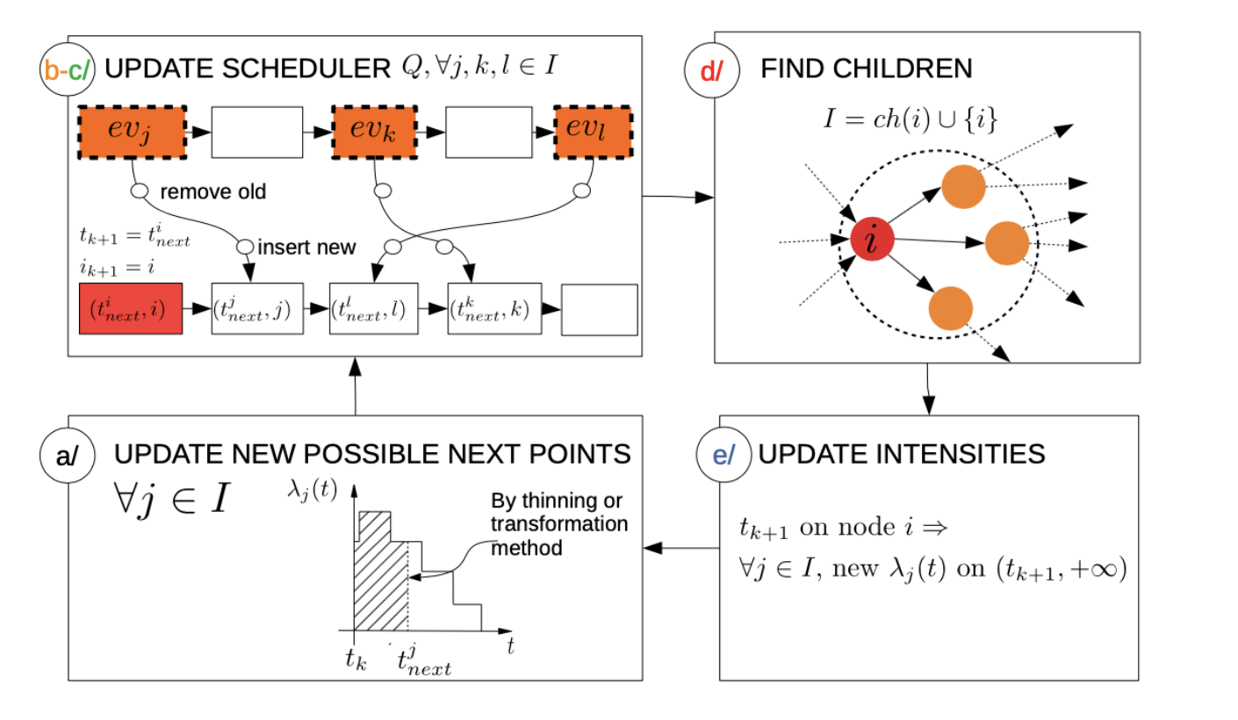
Activity Tracking with Time Asynchrony (ATITA)
Sparsity of the neuronal network

Slide 18
Comparison with state of the art

Slide 19
Bottleneck in simulation
One of the main problem is the computation of
$φ^{i}\left(t\right)=ν^{i}+\sum_{j presyn. of i}{\int_{0}^{t}{ h_{j→i}\left(t−u\right)dZ^{j}\left(u\right) }}$
Use randomness to interpret sum as expectation …. For instance,
$φ^{i}\left(t\right)=ν^{i}+”𝔼(\int_{0}^{t}{ h_{J→i}\left(t−u\right)dZ^{J}(u }$)”
with J random variable picking the presynaptic neuron at random
Also possible to pick $J=∅$ to put $ν^{i}$ in the expectation
Also possible to pick the interval in time at random

Slide 20
Kalikow decomposition of time-homogeneous counting processes (Notation)
$x , x_{t}$ = configuration of the points / points in the past
$Z^{i}$ time homogeneous counting processes ass. to neuron i of generic intensity $φ^{i}$
A neighborhood $v$ = finite subset of $I×ℝ_{−}$

Slide 21
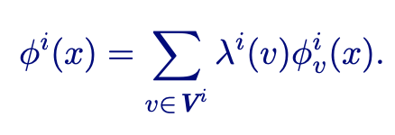
Kalikow decomposition of time-homogeneous counting processes
There exists $V$, a probability $λ^{i}$ on $V$ and $φ_{v}^{i}$cylindrical on $v$ for all $v∈V$, s.t.
This holds for all past configuration $x$ rooted in 0, under certain smoothness condition (e.g. $φ^{i}(x)<∞$ )
NB : previous work by Hodara and Löcherbach (2017) = $λ^{i}\left(v\right)$ depends on underlying Poisson process $Π$

Slide 22
Thinning representation of Kalikow
Let $Π^{i}(dt,du,dv)$ Poisson of mean measure $dt du λ^{i}(dv)$
Then the process $Z^{i}$ defined by
is of generic intensity
INFORMAL ALGORITHM
Simulate (T,U) as before,
Add a mark V at random according to $λ^{i}$
Do as if the intensity is $φ_{V}^{i}$ instead of the much more complex $φ^{i}$

Slide 23
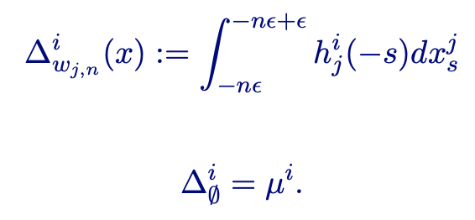
Example : the linear Hawkes process in continuous time
Generic Intensity
Family of atomic neighborhood : $∅$and
So whatever $λ(w_{j,n})$>0, $φ_{w_{j,n}}^{i}\left(x\right)=Δ_{w_{j,n}}^{i}(x)/λ(w_{j,n})$

Slide 24
Backward-Forward algorithm
8/12
Poisson process may have no point
Neighborhood selection
Poisson process with rate $Γ^{l}$
?
?
X
Neuron l
Neighborhood selection
X
?
?
Neuron k
Simulation only on what has not appeared yet
$ℰ$($Γ^{i}$)
$$∅$$
$$∅$$
Once all necessary points have been created, I decide if I keep them with probability${ φ}^{v}(x)/Γ$
$$t_{0}$$
Select empty neighborhood
?
Neuron i
Until first point is decided

Slide 25
End of the backward steps and perfect simulation
Let
Then if
The Backward steps ends almost surely
This simulates a stationary process for $Z^{i}$ in a potential infinite network
→ simulation of an OPEN PHYSICAL SYSTEM
For linear Hawkes on finite networks, see also Möller and Rasmussen (2005), Chen and Wang (2020)
→ existence of a stationary solution for the Hawkes process with refractory period
(with additional assumptions) estimate on the number of produced points.
with $μ$ the Lebesgue measure

Slide 26
In practice
8/12
One neuron in a Complete Infinite network with polynomially decreasing interactions

Slide 27
Contents
Kalikow decomposition in a nutshell (with a bit of neuroscience) and its classical application (existence)
→ Simulation of Spiking Neural Network
Derivation of local learning rules

Slide 28
ANN versus SNN

Slide 29
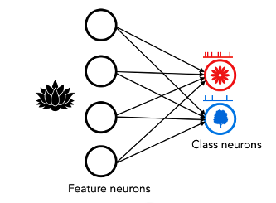
A toy model of SNN with Hawkes
The class/output neurons are Hawkes processes in discrete time
Kalikow says
→ Pick at random the influencing neuron according to some probability depending on the neuron
$$φ^{j}\left(t\right)=\sum_{i→j}{λ_{i→j }\int^{t}{g\left(t−u\right)dZ_{u}^{i}}}$$
Use this interpretation to inject expert aggregation algorithms locally

Slide 30
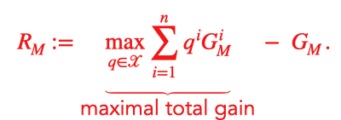
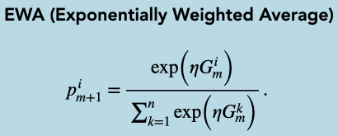
Expert aggregation in a nutshell
Regret to minimize

Slide 31
HAN: Hawkes aggregation of Neurons

Slide 32
Class discrepancy

Slide 33
An oracle inequality for HAN Solo

Slide 34
Other results for HAN
Exists in a non linear case with inhibition
For particular expert aggregation, explicit computations of the limit
Works on simulation
Version with multiple layers and aggregation based on correlation structure
Version in continuous time with
Brownian limits and modelling of reaction time

Slide 35
Final conclusions and remarks
Kalikow decomposition is great !
For mathematical proofs
For simulation
For interpretation
But not really unique → could we estimate it ??
(see recent work of Ost and Takahashi)

Slide 36
Thank you ! Questions ?
KALIKOW, S. (1990). Random Markov processes and uniform martingales. Israel J. Math. 71 33–54.
BRAMSON, M. and KALIKOW, S. (1993). Nonuniqueness in g-functions. Israel J. Math. 84 153– 160.
FERRARI, P. A., MAASS, A., MARTÍNEZ, S. and NEY, P. (2000). Cesàro mean distribution of group automata starting from measures with summable decay. Ergodic Theory Dynam. Systems 20 1657–1670.
COMETS, F., FERNÁNDEZ, R. and FERRARI, P. A. (2002). Processes with long memory: Regenerative construction and perfect simulation. Ann. Appl. Probab. 12 921–943.
GALVES, A., GARCIA, N.L., LOCHERBACH, E. and ORLANDI, E. (2013) Kalikow-Type decomposition for multicolor infinite range particule systems. Ann. Appl. Probab. 23 (4) 1629-1659.
GALVES, A. and LOCHERBACH, E. (2013) Infinite Systems of Interacting Chains with Memory of Variable Length—A Stochastic Model for Biological Neural Nets. J. Stat. Phys. 151:896–921
OST,G. and REYNAUD-BOURET, P. (2020) Sparse space-time models: concentration inequalities and Lasso, Annales de l'IHP, Probabilités et Statistiques 56(4), 2377-2405
Phi, T. C., Muzy, A. and Reynaud-Bouret, P. (2020) Event scheduling algorithms with Kalikow decomposition for simulating potentially infinite neuronal networks, SN Computer Science, 1(35)
Mascart, Cyrille ; Scarella, Gilles ; Reynaud-Bouret, Patricia ; Muzy, Alexandre Scalability of Large Neural Network Simulations via Activity Tracking with Time Asynchrony and Procedural Connectivity Neural Computation, 34(9), 1915-1943 (2022)
Mascart, Cyrille ; Hill, David ; Muzy, Alexandre ; Reynaud-Bouret, Patricia Efficient Simulation of Sparse Graphs of Point Processes, ACM Transactions on Modeling and Computer Simulation, 33(1-2), 1-27 (2023).
Phi, T. C., Löcherbach, E. and Reynaud-Bouret, P. (2023) Kalikow decomposition for counting processes with stochastic intensity and application to simulation algorithms, Journal of Applied Probability
Jaffard, S., Vaiter, S. Muzy, A. and Reynaud-Bouret, P. (2024) Provable local learning rule by expert aggregation for a Hawkes network, AISTAT

